Slide 1
Experiments with scene text recognition
Chen-Yu Lee
Phuc Xuan Nguyen

Slide 2
Character detection and recognition

Slide 3
Character Recognition

Slide 4
SVM + HOG

Slide 5
Responses

Slide 6
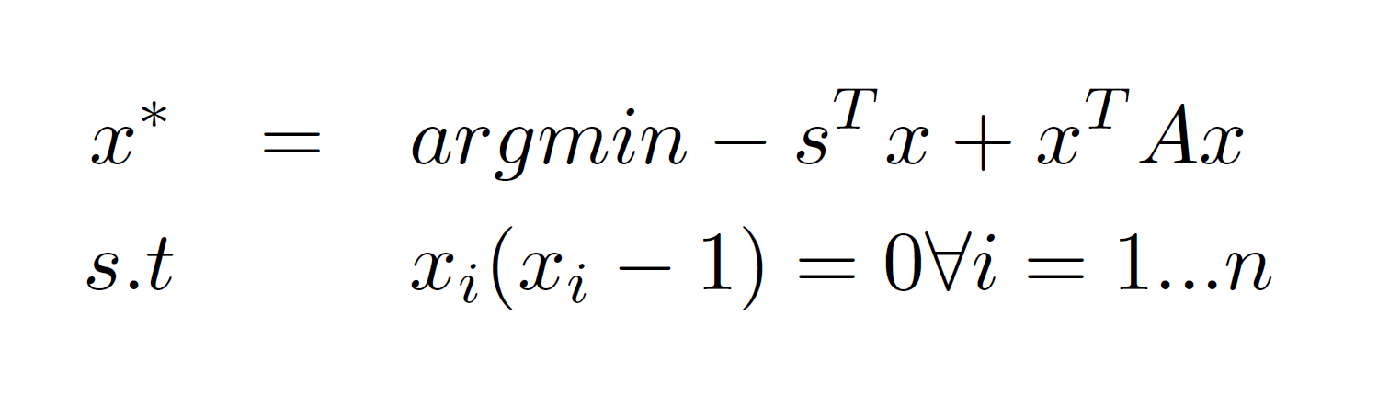
Convex Optimization - Primal
classification scores
cost matrix

Slide 7
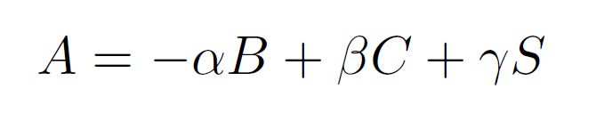
Constructing cost matrices
Bigram probability
Collision
Color similarity

Slide 8
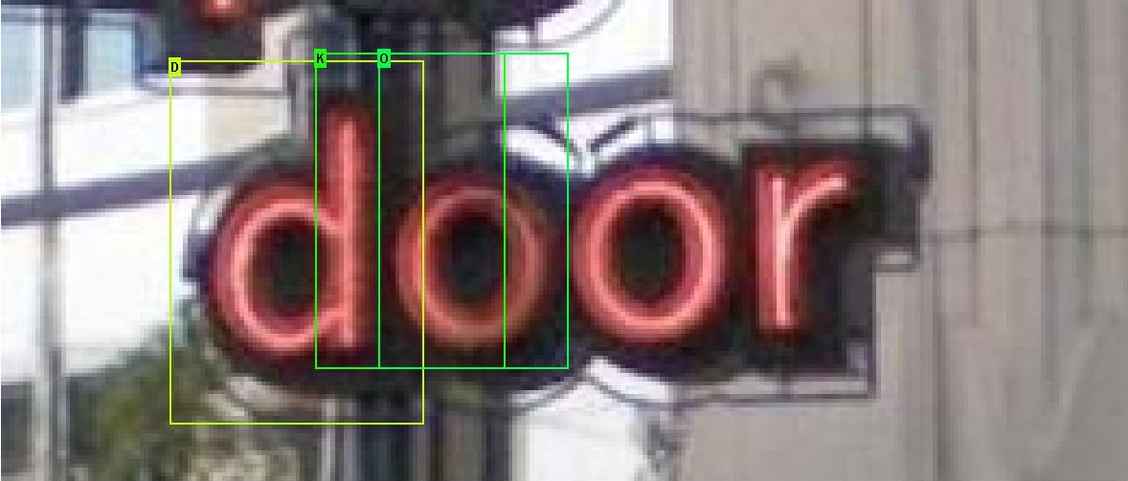
Reasons for cost matrices - Collision

Slide 9
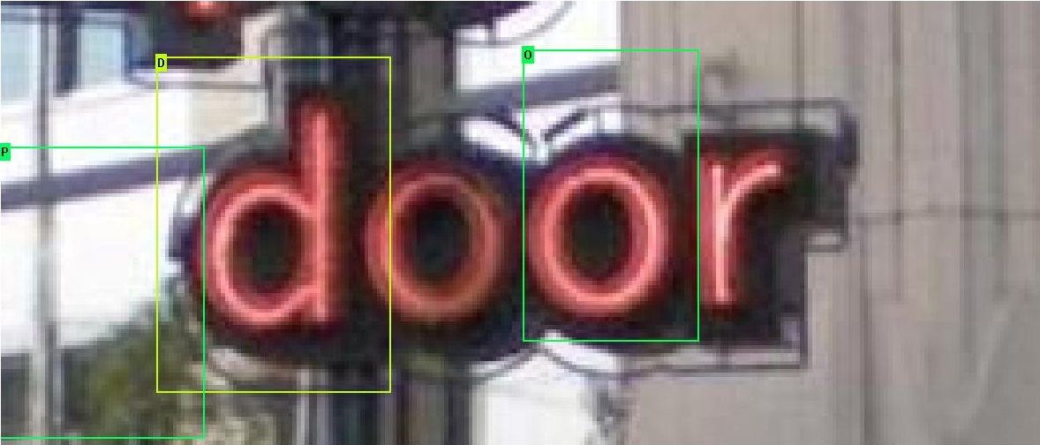
Reasons for cost matrices – Color similarity

Slide 10
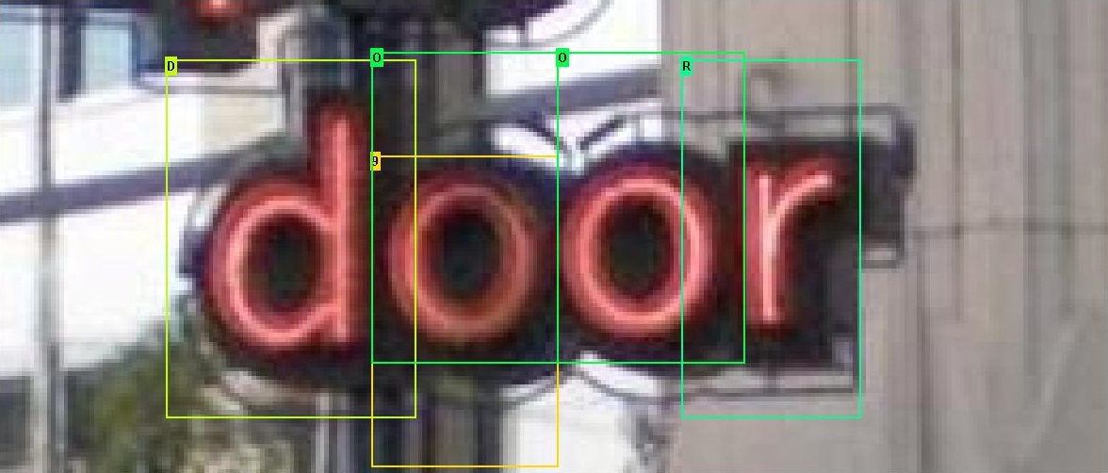
Reasons for cost matrices – Bigram

Slide 11
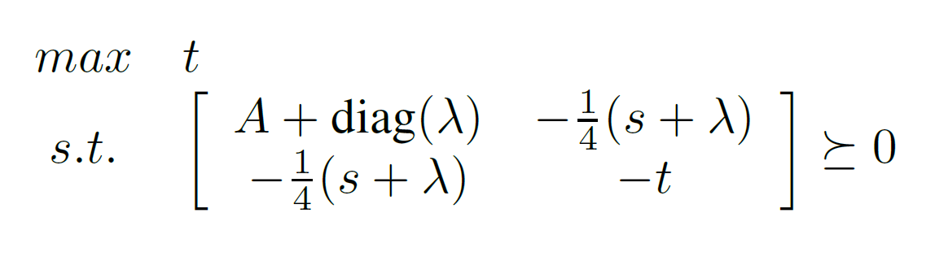
Dual SDP

Slide 12
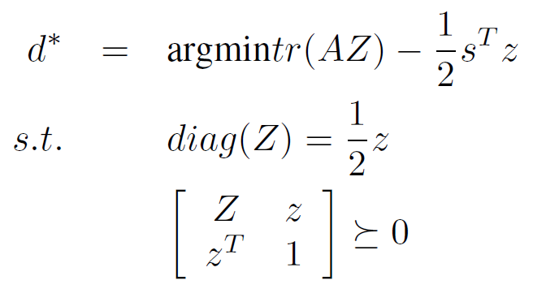
Relaxation

Slide 13
Experiments
Abc

Slide 14
Results

